Slide 1
WO3196 H2 drop test
0120_1636_WO3196_ohmic_vacToH2
Measurement is done with current sourcing
Sample rate is 4 Hz
Measurement time is 1800 s
Source current is 1e-07 A
Limit voltage starts at 10.0 V
Temperature setpoint is 2.50e+01 C
Mean current is 1.000000e-07 with std 1.323489e-23
Mean temperature is 2.500469e+01 with std 1.299261e-02
Measurements:
Air 5 min
Vacuum 5 min
Vacuum 5 min
Vacuum to H2 30 min
H2 10 min
H2 10 min

Slide 2
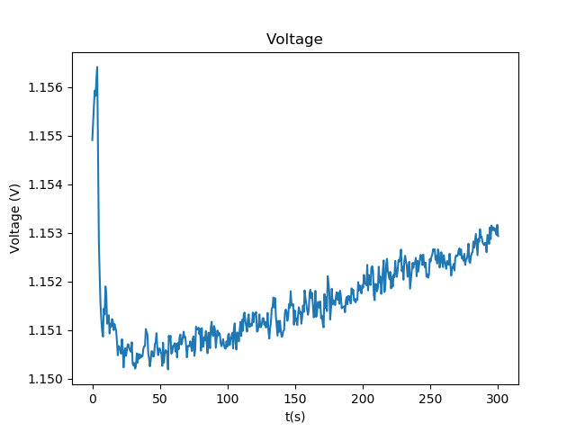
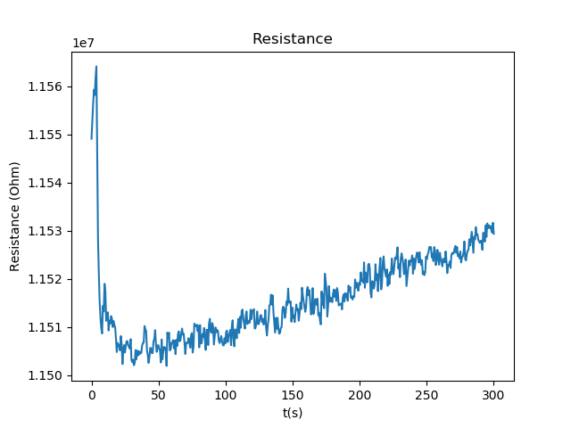
Air static
0120_1609_WO3196_ohmic_air

Slide 3
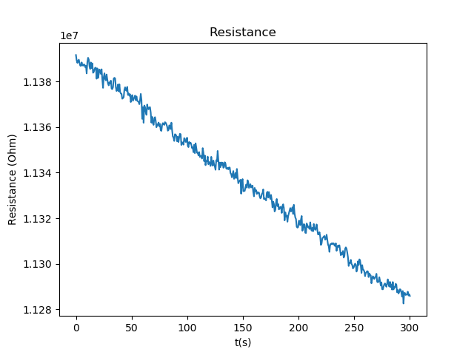
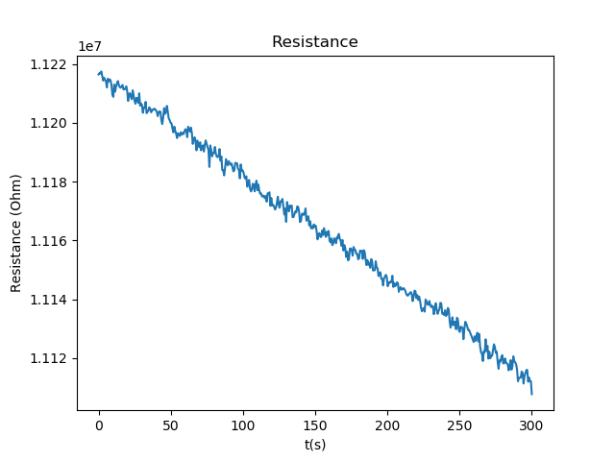
Vacuum
1
2

Slide 4
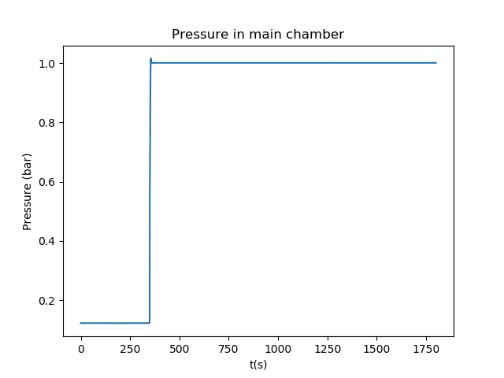
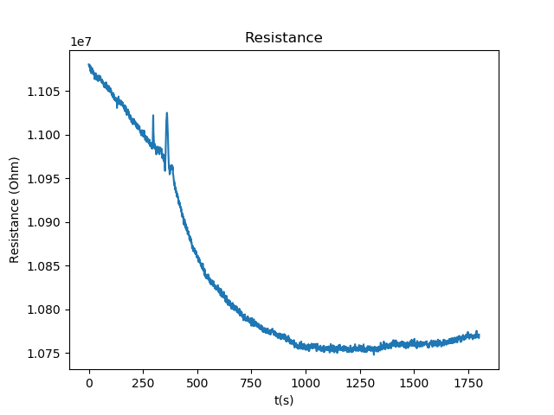
Vacuum to H2

Slide 5
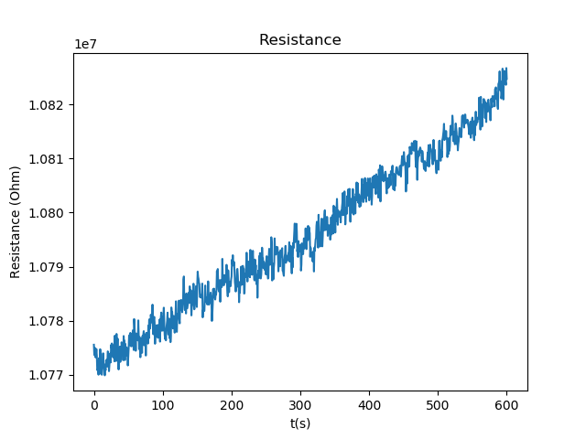
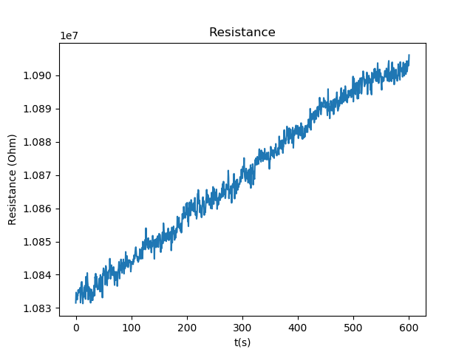
H2
1
2

Slide 6
H2 measurement #2 vs H2 drop

Slide 7
Notes
H2 drop is very small, 0.3e7 Ohm
So it is only somewhat larger than the drift of 0.1e7 Ohm
After this I discover that covering the window influences the resistance of the sample, so will cover it up and measure again

